Slide 1

Name: DURGA ADHIKARI CHHETRI
Enrollment No: 19LRTDC0418
Roll No: 01
Class: TYCS
Semester: VI
Prof-in Charge: Asst.Prof. Rutika Malik

Slide 2
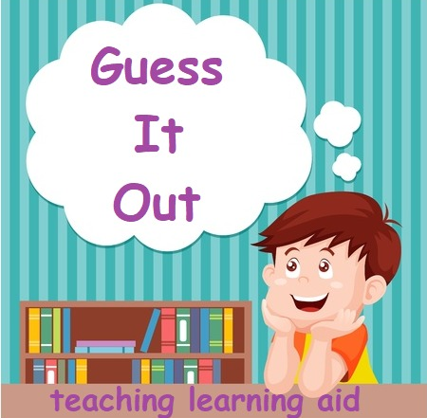

Slide 3
INTRODUCTION
Quiz is popular among children who have been taught with the whole or sight word method and solve method.
This is a simple project to help your kids grow in IQ.
Children have some difficulties in vocabulary and speaking English. They also have problem solving simple math problems
The use of games in the teaching and learning process is very influential in building student enthusiasm and participation.
Games can also strengthen students' self-confidence and students' courage to speak.
Games are one of the activities that teachers can use to teach speaking English.

Slide 4
OBJECTIVES
To make the sessions interactive.
To help children learn new vocabularies.
To improve children solving ability.
To make classroom games as a teaching strategy.
To help children improve their IQ.
To help teachers make learning fun and useful.

Slide 5
PROPOSED SYSTEM
This project is an interactive Python Game with a Graphical User Interface. The project contains the user side and database. It stores the user’s given information on the database. The game has music to make it more enjoyable. After the account is created the player has to login by filling username and password. The home page has two fields: Math and English and let’s Learn button. On clicking let’s Learn button you will be directed to page that contains white board for writing and buttons to generate multiplication table, reset and exit. After selecting the desired field, the user can choose difficulty level accordingly. Each difficulty level has two submodules: Level1 and Level2. They have to unlock the level to play. Players are able to see the overall high score. The high score is stored in text format. Game has logout button. If the player forgets the password, then they can change the password with the help of forgot password button. The design of this project is pretty simple so that the player won’t find any difficulties while working on it.

Slide 6
REQUIREMENT SPECIFICATION
HARDWARE REQUIREMENT:
Memory: Minimum 1GB RAM
Internal Storage: Minimum 1GB
SOFTWARE REQUIREMENT:
Tool: Pycharm IDE
Language: Python
GUI: TKinter
Module: Random, Time, Sqlite3, Pygame
System: WINDOWS
USER REQUIREMENT:
Application: Desktop
OS: Windows

Slide 7
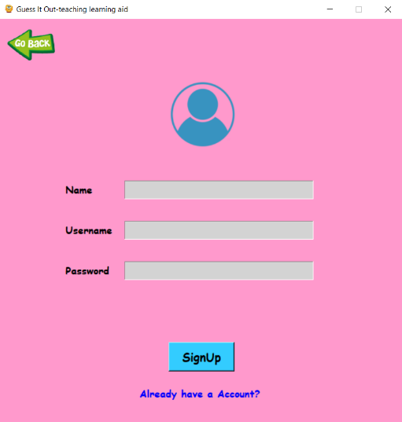
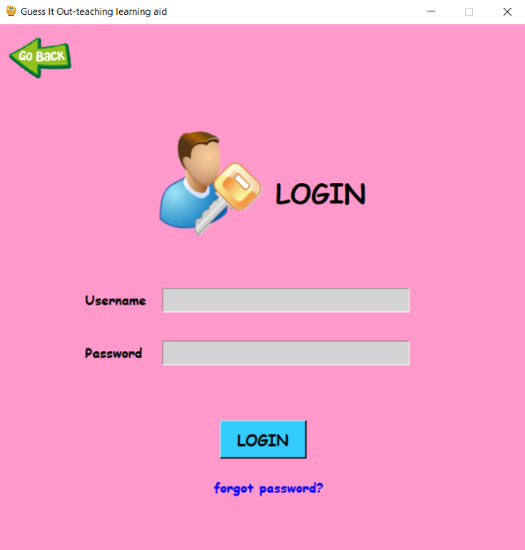
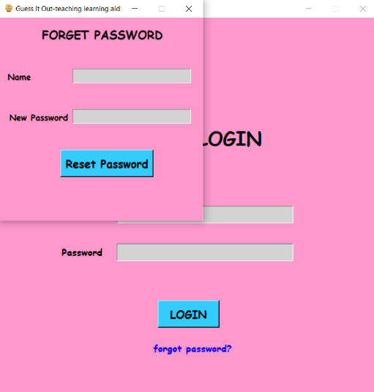
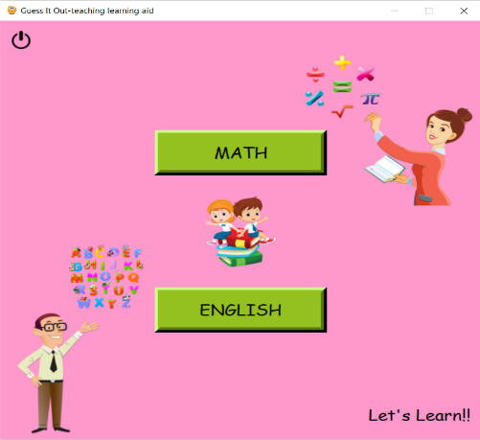
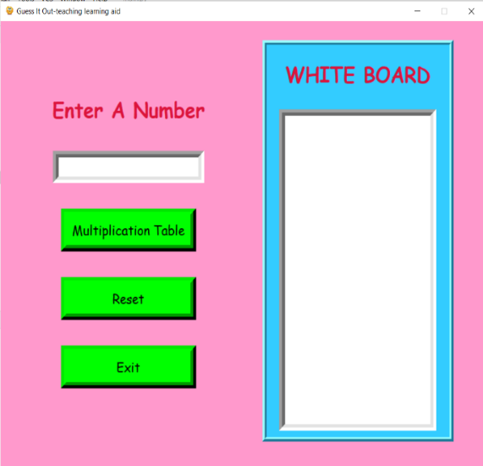
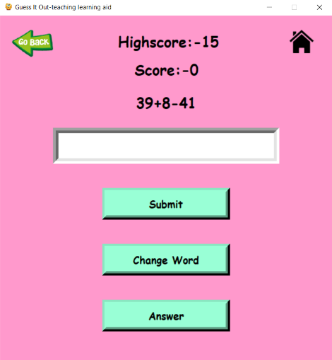
RESULT
Background Music is present in the game.
Account creation is necessary to play.
Forgot password to change password.
Math and English- two modules to play.
Levels are locked.
Difficulty level of the game can be selected.
High score can be viewed.
Activity area to learn and write notes.
Logout button.

Slide 8
CONCLUSION
This is a humble project to make user learn and grow in IQ. Several user friendly code has been adopted and more future enhancement are available according to user needs. It will prove to be a powerful game for satisfying all further requirement of schools. The key concept is to make the learning session interactive and focused. It can be observed that the information required can be obtained with ease and accuracy on the computerized system. The user with minimum knowledge about computer can be able to operate the system easily.

Slide 9
FUTURE SCOPE
The application can be easily implemented under various situations. We can add new features when required.
Reusability is possible and can be customer made.
Project can be used as a base for higher level learning games with use of new technologies on it.
It is likely to attract large % of students and teachers to engage on it.
It is very broad in terms of gaining and sharing knowledge among world.
This application will be used in educational institutions as well as in corporate world.

Slide 10
THANK YOU!!

